Slide 1
超越学科界限的认知基础 Transdisciplinary Cognitive Foundation Namespace Management Week 2
Ben Koo
September 21, 2020

Slide 2
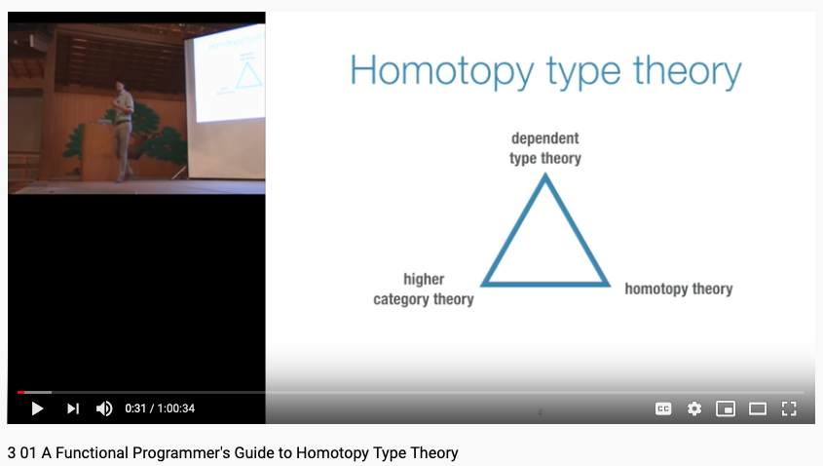
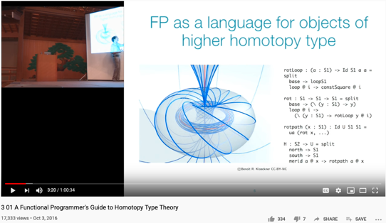
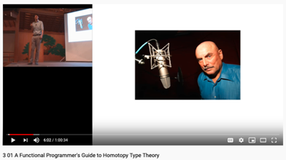
This is not just a SOUND TEST, it is also a story about Data in a world where …
Don Lafontaine
A transdisciplinary foundation in math and programming by Prof. Dan Licata, Wesleyan University

Slide 3
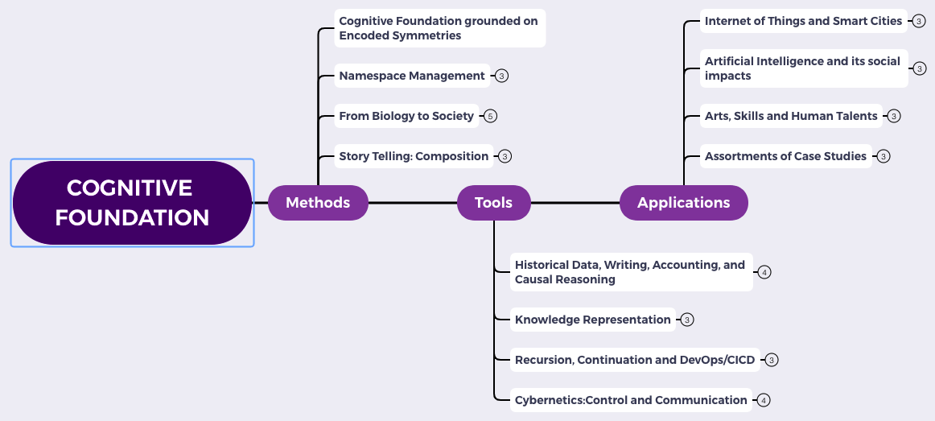
Content Themes for the semester
Overview
Namespace Management
Biology, Physics, Math, Code is Law, and Society
Story Telling, Functions/Metaphors/Analogies
Writing, Accounting, Historical Data and Temporal Reasoning
Knowledge Representation in Wiki and Files
Recursion and Continuation (DevOps/CICD)
Midterm Reports by Students
Cybernetics (Control and Communication)
Smart City and Internet of Things
Artificial Intelligence and its Social Impacts
Arts/Skills/Human Talents in the Digital Era
Student proposed Application Topics
Rehearsal
Final Reports and Celebration

Slide 4
Glossary
Terms related to Name Space Management:
Ontology/本体论: the philosophical study of being. (Wikipedia)
Epistemology/知识论: a theory of knowledge, (Standord Philosophy Encyclopedia)
Universal Resource Locator/Indicator(URL/URI) : a string representing global resources
NsM related Ideas:
CAP Theorem: Consistency, Availability, and Performance face contentious tradeoffs.
System properties: Correctness = Liveness * Safety, Trust-worthy Data

Slide 5
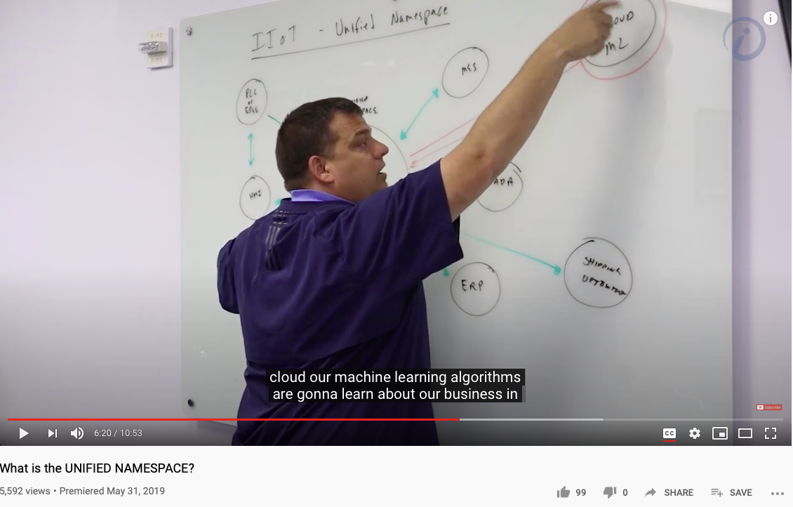
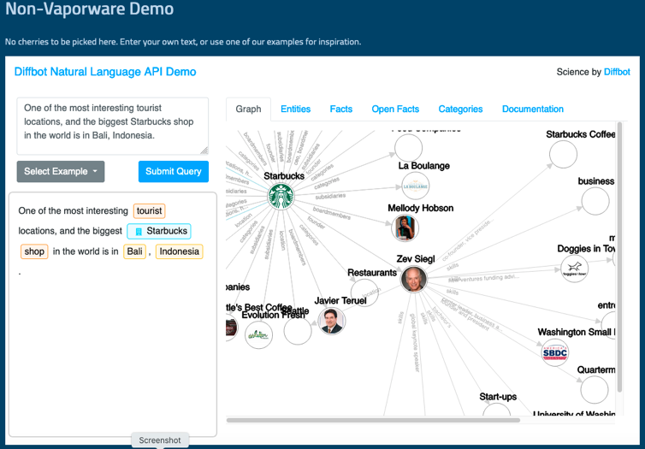
Unified Namespace

Slide 6
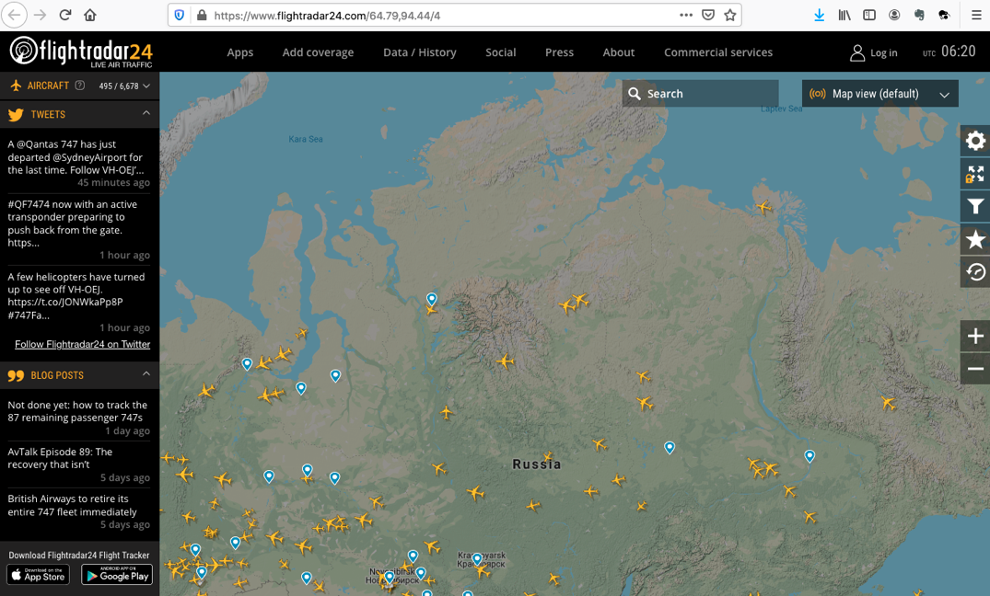
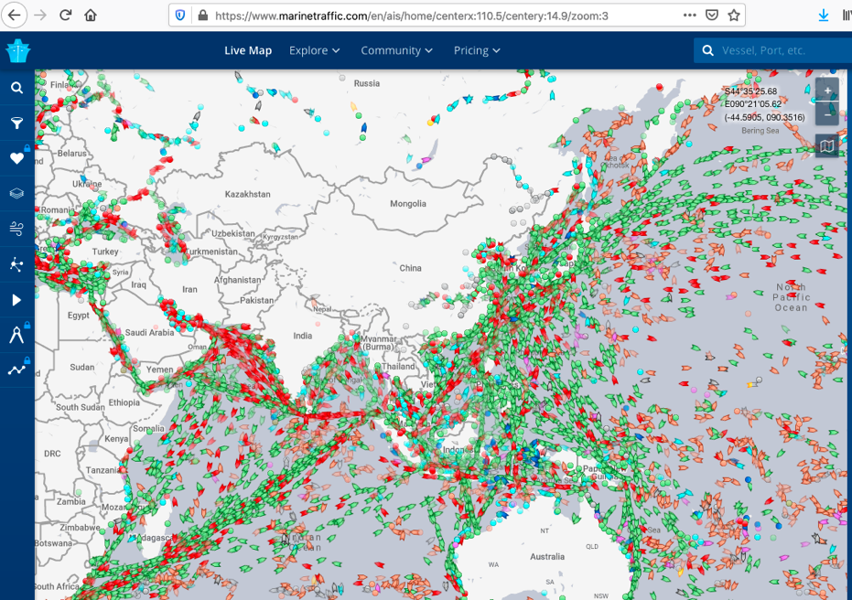
Get access to Live Data Now!
https://www.flightradar24.com/
https://www.marinetraffic.com/

Slide 7
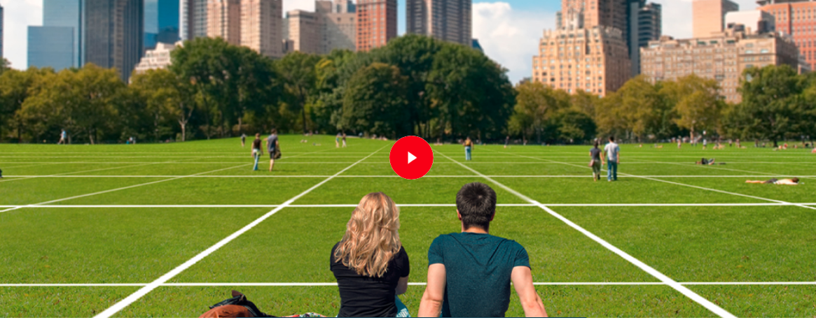

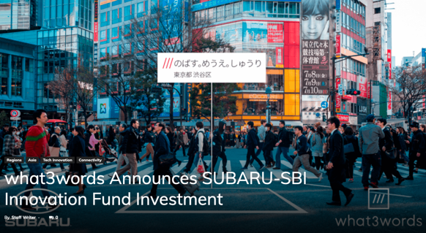
An example of Namespace Management

Slide 8
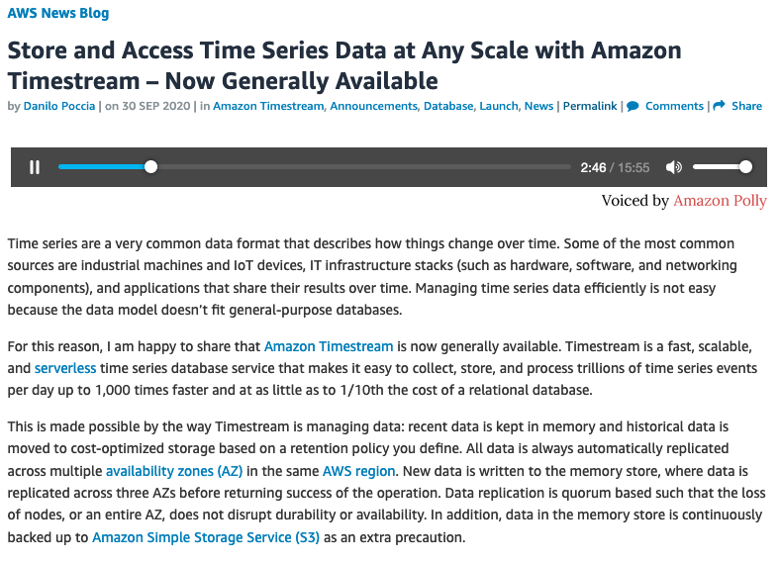
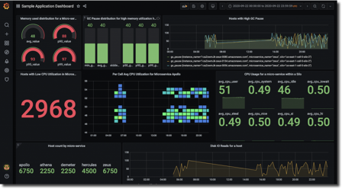
Namespace Management in Time

Slide 9
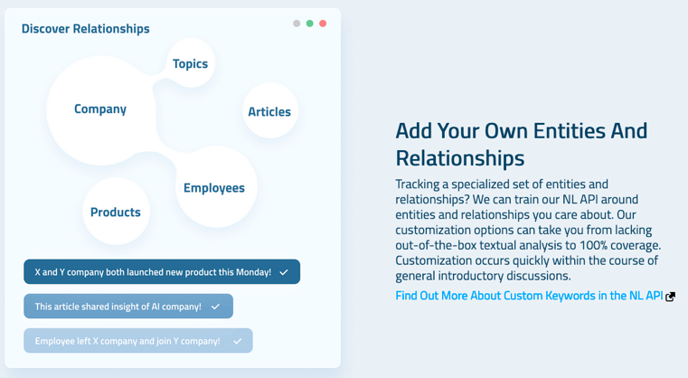
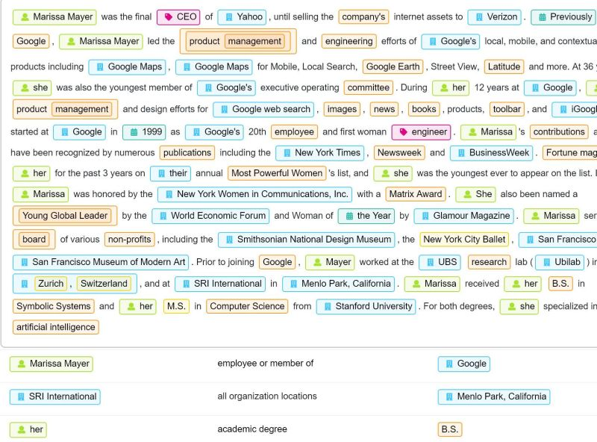

Diffbot (more than 1 Trillion linked entities)

Slide 10
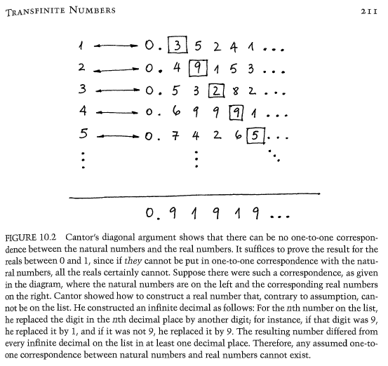
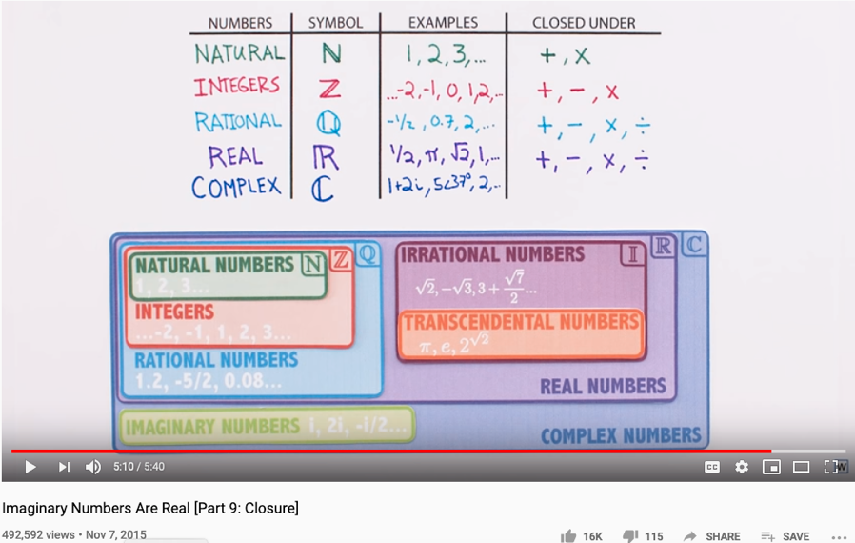
The Complete set of Generative Names
Huawei VP Mr. Yang Shaoqing

Slide 11
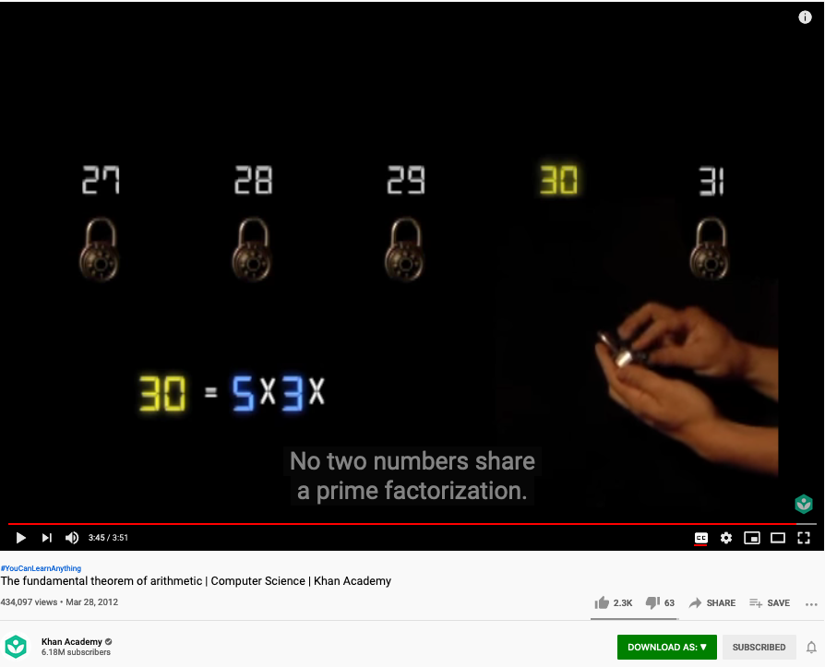
The Fundamental Theorem of Arithmetic (Name Space Management Trick)
Huawei VP Mr. Yang Shaoqing
https://youtu.be/8CluknrLeys?t=225
The fundamental theorem of arithmetic | Computer Science | Khan Academy

Slide 12
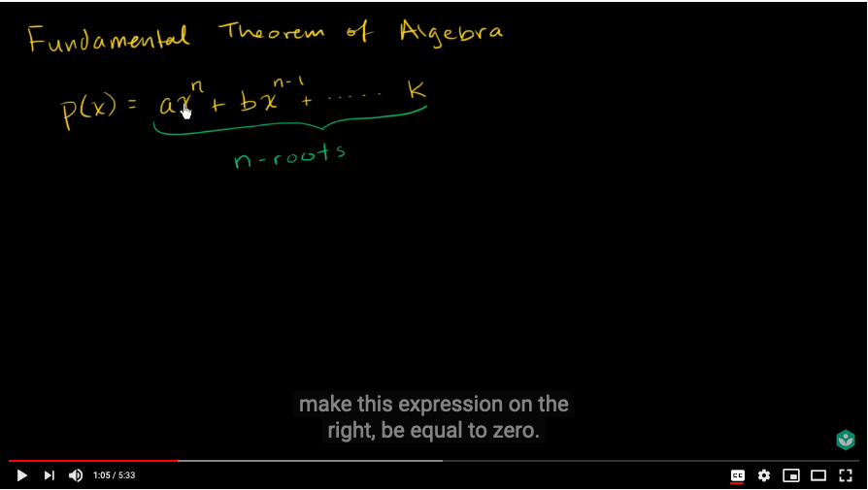
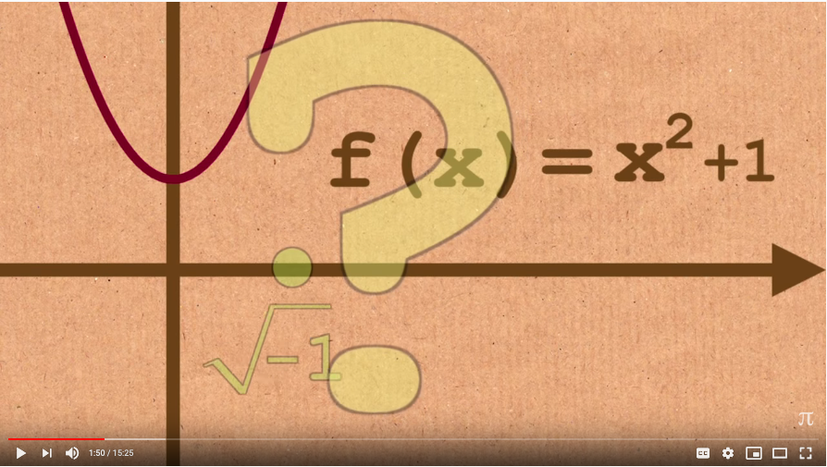
The Fundamental Theorem of Algebra
Huawei VP Mr. Yang Shaoqing
https://youtu.be/d8-LO6FCna0?t=65
https://youtu.be/shEk8sz1oOw?t=110
Fundamental theorem of algebra | Khan Academy
Fundamental Theorem of Algebra - Numberphile

Slide 13
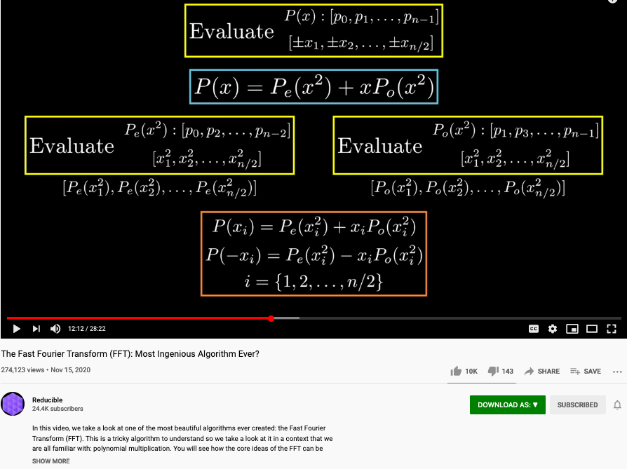
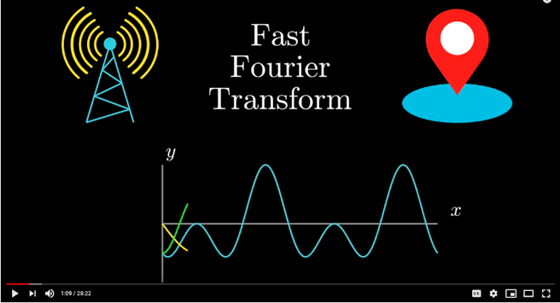
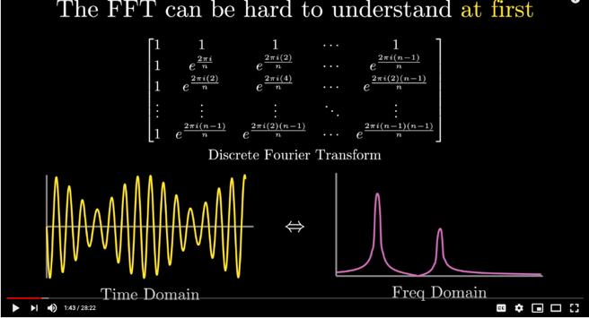
The Polynomial trick also appears in Fast Fourier Transform
Huawei VP Mr. Yang Shaoqing
https://youtu.be/h7apO7q16V0?t=732

Slide 14
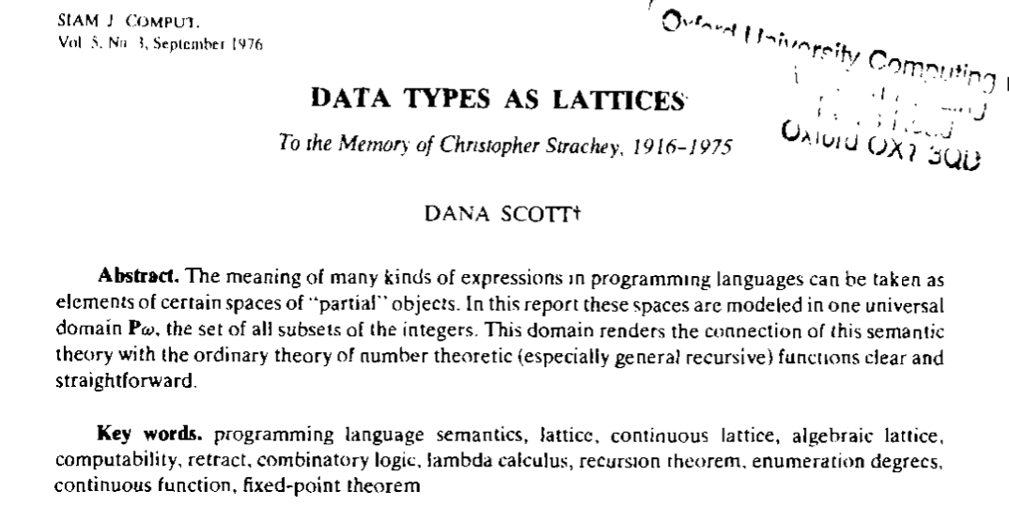
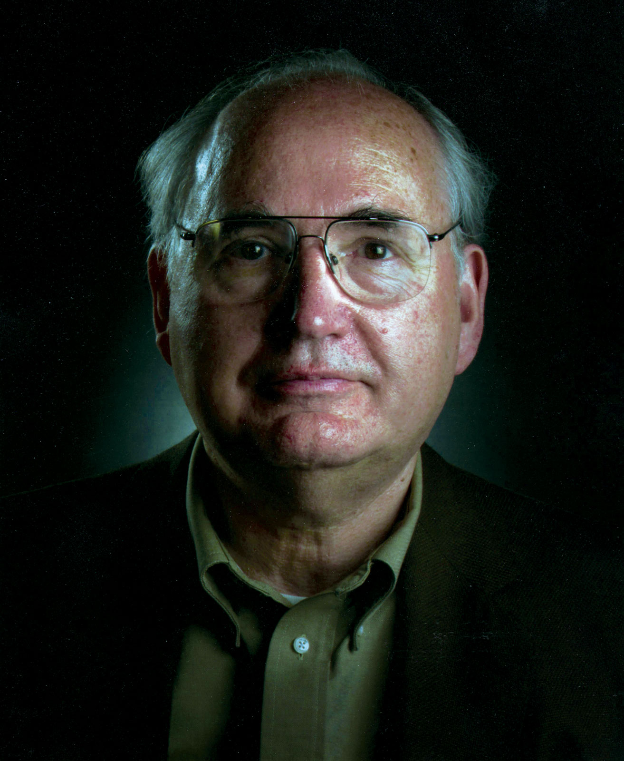
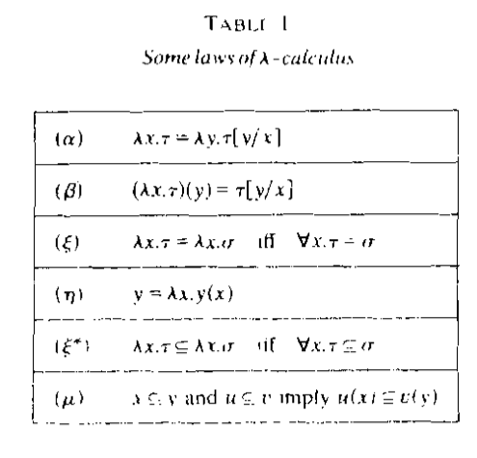
All meaningful expressions can be modeled as $𝒫ω$
Prof. Dana Stewart Scott
Image Source: Britannica

Slide 15
What is the minimum Symbol Space?
Huawei VP Mr. Yang Shaoqing

Slide 16
Is binary valued system the smallest symbol set?
Huawei VP Mr. Yang Shaoqing

Slide 17
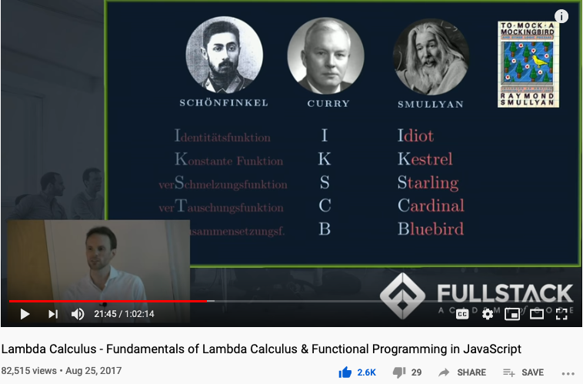
Computable Logic and Types of “Birds”

Slide 18
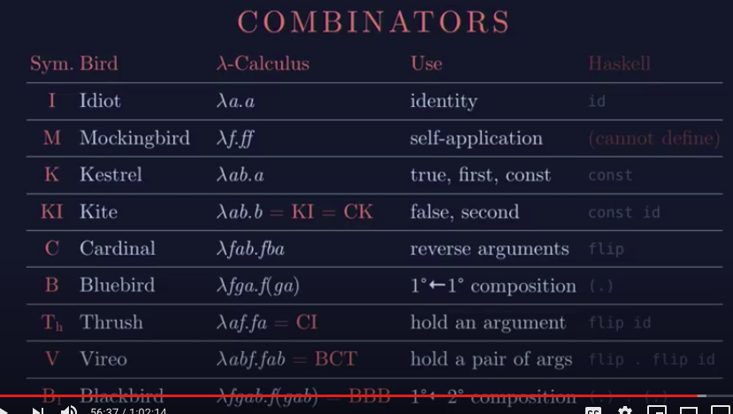
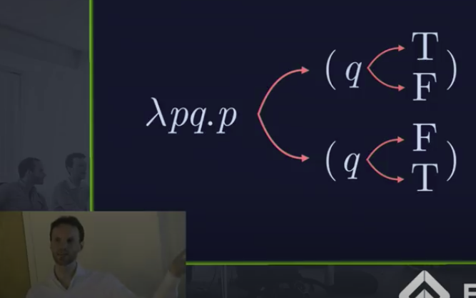
The Names of Birds (Functions)

Slide 19
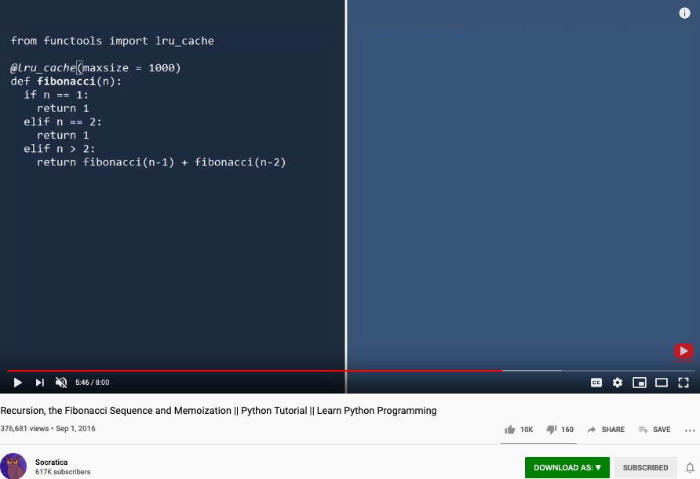
Memoization
An important technique to manage names dynamically!

Slide 20
Maybe we should teach Math in a different sequence
The notion of Pureness
Approximation to Idealized Truth
A curriculum modeled after
Curry-Howard-Lambek Correspondence

Slide 21
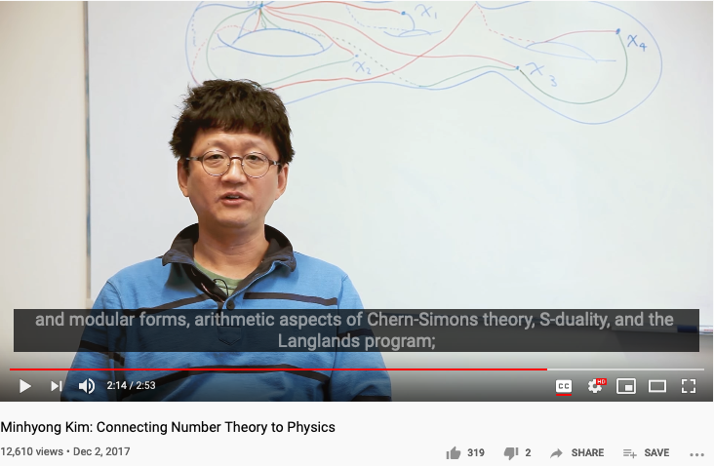
Number Theory, Physics, and Geometry
Huawei VP Mr. Yang Shaoqing
RICH 70 Tsinghua SEA Cloud Forum, Sep 14, 2020
H. E. Bambang Brodjonegoro,
Minister of Research & Technology, Indonesia
Ninhyong Kim has been a research professor of number theory at the University of Oxford and the head of their number theory research group.

Slide 22
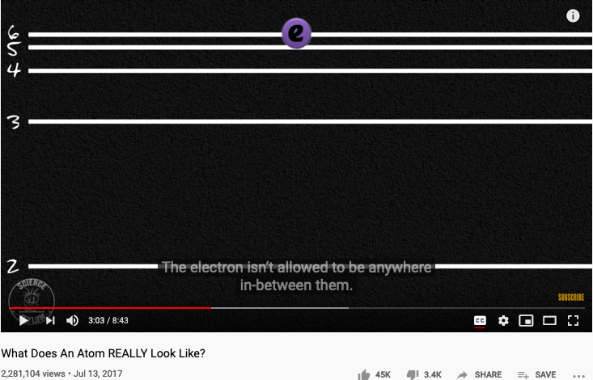
The origin of Atomic Elements
Huawei VP Mr. Yang Shaoqing
RICH 70 Tsinghua SEA Cloud Forum, Sep 14, 2020
H. E. Bambang Brodjonegoro,
Minister of Research & Technology, Indonesia

Slide 23
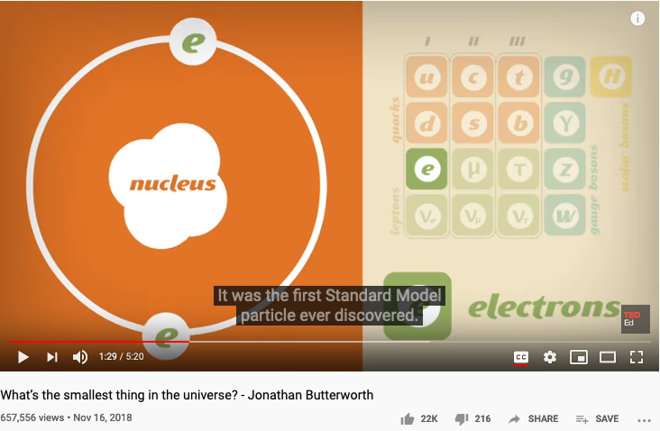
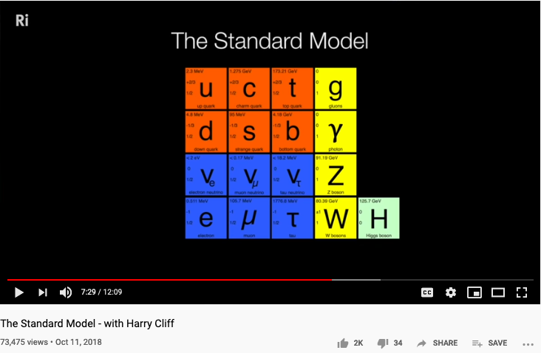
The known set of Elementary Particles
Huawei VP Mr. Yang Shaoqing
RICH 70 Tsinghua SEA Cloud Forum, Sep 14, 2020
H. E. Bambang Brodjonegoro,
Minister of Research & Technology, Indonesia

Slide 24
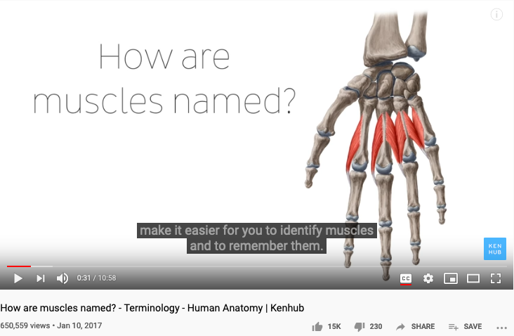
The way medical doctors talks about Human Anatomy
Huawei VP Mr. Yang Shaoqing

Slide 25


How mathematicians and musicians talks about Music
Huawei VP Mr. Yang Shaoqing
RICH 70 Tsinghua SEA Cloud Forum, Sep 14, 2020
H. E. Bambang Brodjonegoro,
Minister of Research & Technology, Indonesia

Slide 26
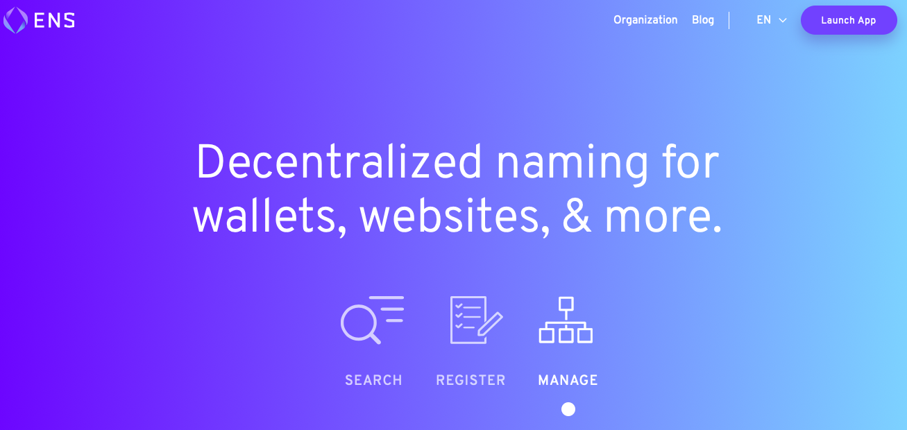
A Way to Get Internet Domain Name Service
Huawei VP Mr. Yang Shaoqing

Slide 27
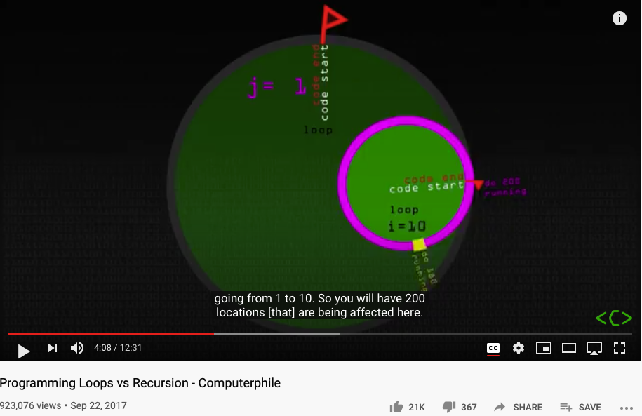
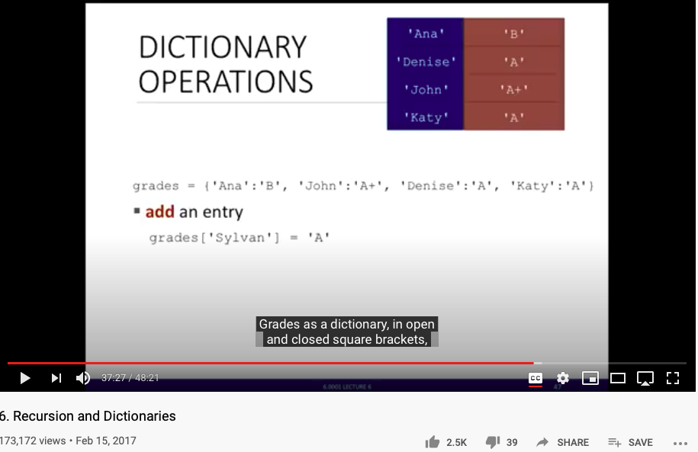
NsM in Loops and Recursion

Slide 28
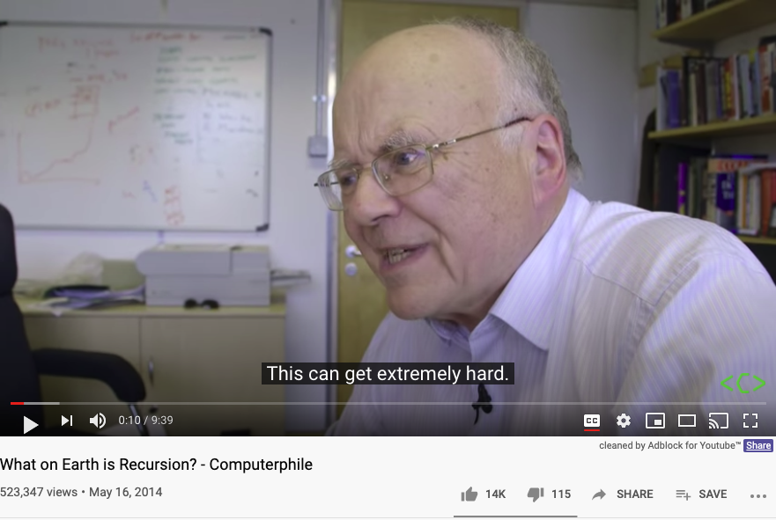
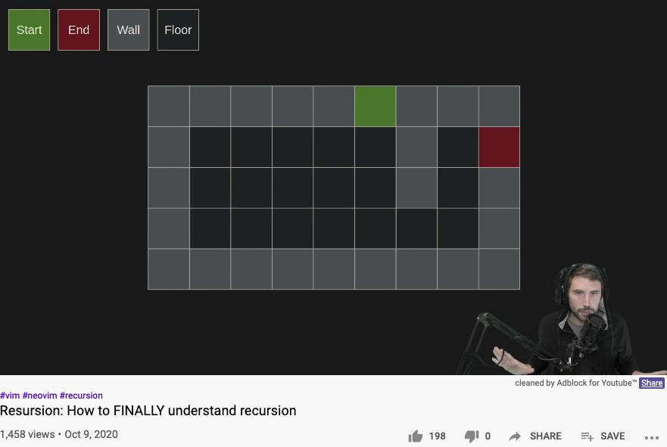
Another Round at Recursion

Slide 29
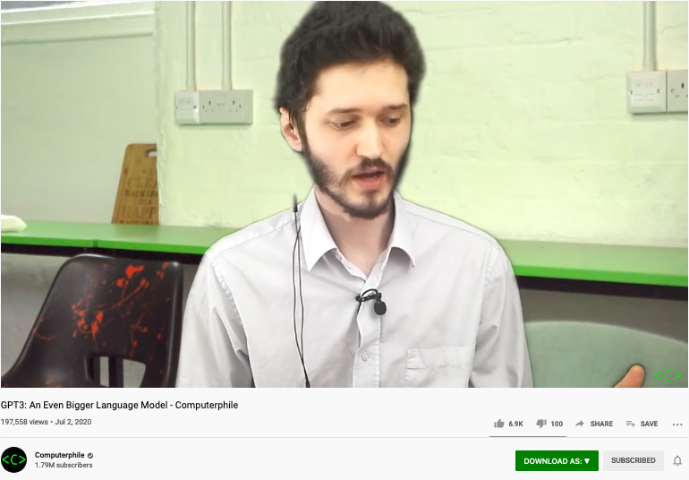
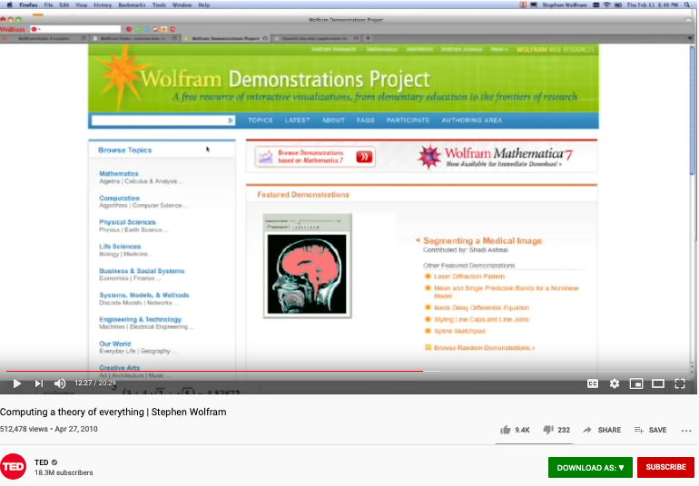
Namespace at Scale
GPT-3 A very large vocabulary to date
An earlier industrialized computable vocabulary
175 Billion Parameters

Slide 30
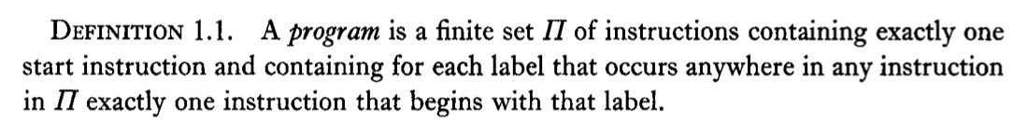
First Approximation If there are called the same name, they must be equal.
For example …

Slide 31
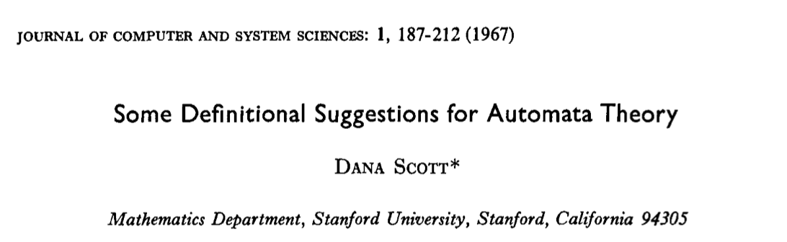
Definitional Suggestion for Computing Science

Slide 32
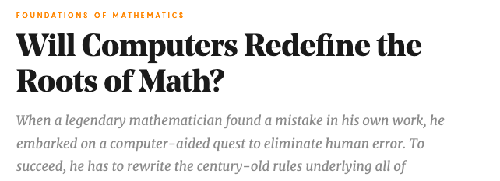
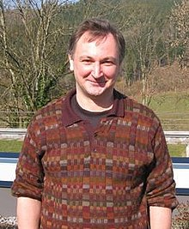

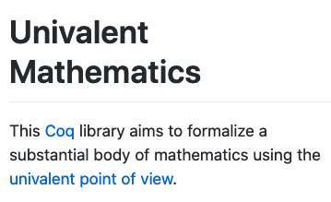

The man who redefined Equal in Math!
By Kevin Hartnett
Vladimir Voevodsky

Slide 33
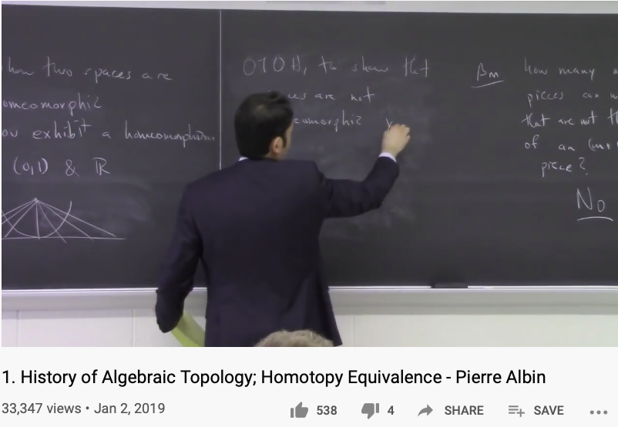
Review the history of Algebraic Topology
Prof. Pierre Albin

Slide 34
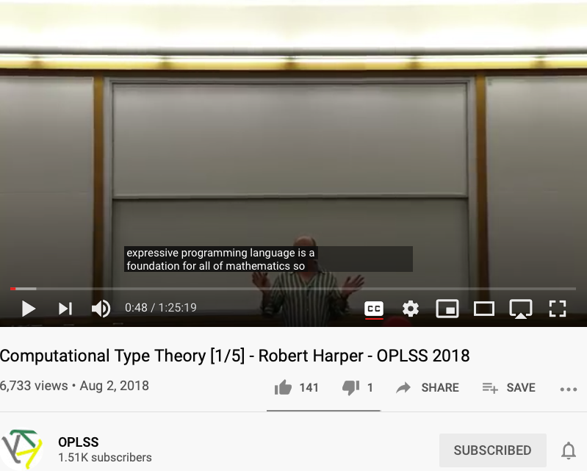
The foundation of math as programming languages
Prof. Robert Harper

Slide 35
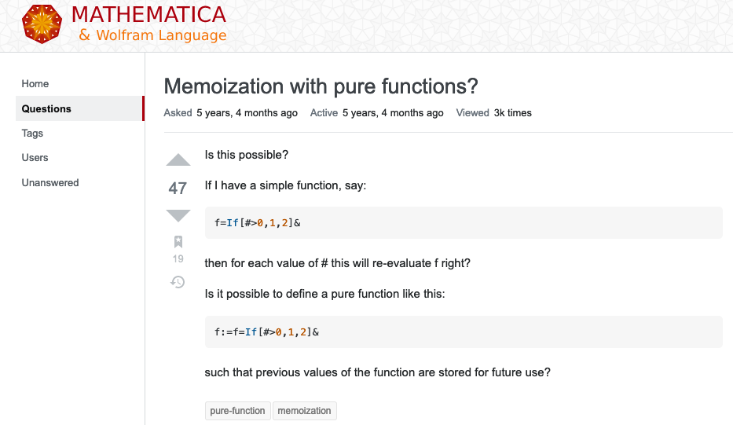
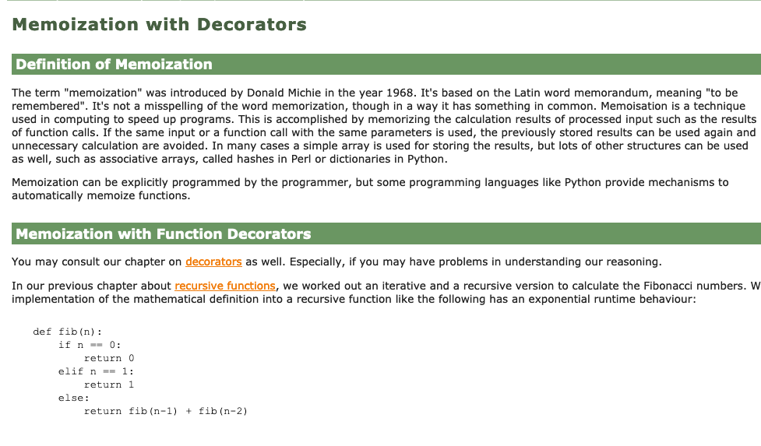
Memoization: Remember Generated Names

Slide 36
In Pure Computation: Function is the ONLY thing.
Primitive Func
Func1
Func2
𝜆
fVar
Func(fVar…)
( )
Functions

Slide 37
The Universal Structure in 𝜆-Calculus Form
Expression := Contextualized Data (* Known interpretation results, no computation *)
| Goal_Exp Criteria_Exp (* Timeless and Time-based expressions *)
| 𝜆 Input Output_Exp(Input) (* A Computing Process *)
| ( Exception_Handling ) (* Stated boundary conditions/Exceptions *)
This set of rules can be used recursively to generate an infinite amount of expressions.
What
Contextualized data
Goal Expr
Criteria Expr
Why
𝜆
Input
Output Spec
How
( )
Exception Handling

Slide 38
A Logic Model is a Function
Context: Describe the Spatial and Temporal boundaries of the project.
Abstract Specification
Goal: Mission Statement written in an imperative sentence with reference to “Context”.
Measurable Effects: Conditional statements of the observable implementation outcomes that satisfy the “Goal”.
Concrete Implementation Process
Outputs
A list of noun phrases that declares the deliverable items from proposed activities
Activities
A structured set of actions that depicts implementation activities.
Ideally written in a formalized process specification language
Inputs
Prescribe the required resources to be consumed in the implementation Process
Boundary Conditions: When and how the boundaries of the previously defined ”Context” could be broken?

Slide 39

Lecture Outline

Slide 40


Names gave birth to Cognitive Abilities - Laozi
Huawei VP Mr. Yang Shaoqing
RICH 70 Tsinghua SEA Cloud Forum, Sep 14, 2020
H. E. Bambang Brodjonegoro,
Minister of Research & Technology, Indonesia

Slide 41



The History of True Names
Huawei VP Mr. Yang Shaoqing
RICH 70 Tsinghua SEA Cloud Forum, Sep 14, 2020
H. E. Bambang Brodjonegoro,
Minister of Research & Technology, Indonesia
How Gods are forgotten:
https://youtu.be/xgyMY9w7-ew?t=278

Slide 42

Arts and Sciences of NsM
History of Names
Patterns of Names
Trust-worthy Names
Namespace management is the Cognitive Foundation.

Slide 43
Thinking in Math = Acting in Namespaces
Huawei VP Mr. Yang Shaoqing
Mathematics is the art of giving the same name to different things.^{[10]} Henri Poincaré
Bertrand Russell’s Principles of Mathematics on “Doctrine of Types”
The way to write and organize names becomes the essence.
What methods and tools can be helpful?
RICH 70 Tsinghua SEA Cloud Forum, Sep 14, 2020
H. E. Bambang Brodjonegoro,
Minister of Research & Technology, Indonesia

Slide 44


The Meaning of being True
Huawei VP Mr. Yang Shaoqing
RICH 70 Tsinghua SEA Cloud Forum, Sep 14, 2020
H. E. Bambang Brodjonegoro,
Minister of Research & Technology, Indonesia
Russel once said: “Mathematicians’ job is about classifiying.”
Mathematics is the art of giving the same name to different things.^{[10]} Henri Poincaré

Slide 45


The Necessity of Named abstractions
Huawei VP Mr. Yang Shaoqing
Through abstraction, only compute truth within the domain of interest!
So that it can by pass the Halting Problem.

Slide 46

How to Think Mathematically?
Huawei VP Mr. Yang Shaoqing
RICH 70 Tsinghua SEA Cloud Forum, Sep 14, 2020
H. E. Bambang Brodjonegoro,
Minister of Research & Technology, Indonesia
Russel once said: “Mathematicians’ job is about classifiying.”
Mathematics is the art of giving the same name to different things.^{[10]} Henri Poincaré

Slide 47

True Name defined by Wikipedia

Slide 48




The Book of Why

Slide 49
What, How and Why
What/Association marks data content (naming objects)
How/Intervention demonstrates active intent (human free will)
Why/Counterfactuals checks on associations by breaking symmetry
Branching on the assumptions/contextual groundings
It is the simplicity of data types (associations) that enables scale
All data types share the same basic type (association/arrow/label/named object)

Slide 50
The Universal Structure in 𝜆-Calculus Form
Expression := Contextualized Data (* Known interpretation results, no computation *)
| Goal_Exp Criteria_Exp (* Timeless and Time-based expressions *)
| 𝜆 Input Output_Exp(Input) (* A Computing Process *)
| ( Exception_Handling ) (* Stated boundary conditions/Exceptions *)
This set of rules can be used recursively to generate an infinite amount of expressions.
What
Contextualized data
Goal Expr
Criteria Expr
Why
𝜆
Input
Output Spec
How
( )
Exception Handling

Slide 51

Intensive and Extensive Properties

Slide 52




Labels, Linguistics, and Cognitive Science
Image Source: https://georgelakoff.com/

Slide 53



The expressive power of Names (labels)
Huawei VP Mr. Yang Shaoqing
Prof. George Lakoff

Slide 54

Namespaces as pure abstractions
Video Source: https://youtu.be/TbNymweHW4E?t=246

Slide 55

Categories are Containers of cognitive concepts
Huawei VP Mr. Yang Shaoqing

Slide 56

Patterns of Categories/Classification of Concepts
Grounded Ideas:
Adding (+): including objects into a collection
Subtraction (-): taking objects away from the collection
Sets: containers of elements
Abstract Ideas:
Numbers as points on a line
Geometrical figures as algebraic equations

Slide 57




Combine Operands/Operations as constructed names?
Cayley Table

Slide 58


Names as Generalized Metaphors
Huawei VP Mr. Yang Shaoqing
RICH 70 Tsinghua SEA Cloud Forum, Sep 14, 2020
H. E. Bambang Brodjonegoro,
Minister of Research & Technology, Indonesia

Slide 59


The properties of being Trust-worthy name schemes
Soundness:
All names refer to at least one legal entity
Completeness:
All legal entities must all have at least one name
Controlled Access Rights
Non-repudiation:
Every name only points to one unique legal entity
Tamper-Proof:
Authorized entities can make changes
Any change to the name system must become public knowledge
Time-based:
All name changes should be time-stamped by one coherent clock
Huawei VP Mr. Yang Shaoqing
RICH 70 Tsinghua SEA Cloud Forum, Sep 14, 2020
H. E. Bambang Brodjonegoro,
Minister of Research & Technology, Indonesia

Slide 60



“Mathematics is the art of giving the same name to different things!” - Henry Poincare

Slide 61

How to cope with Infinite Number of Namespaces? Category Theory to the rescue
https://youtu.be/UKIoiO9CSXU?t=341

Slide 62

NsM at Scale!
Relations on the Web
URL: Universal Resource Locator
Universal Data Formats
Physical Objects connected through Namespaces

Slide 63





Namespace Management on the Global Scale
Berners-Lee called his vision for the web “utopian.”
He wanted it to be a place where all people had access to the best information at any time.

Slide 64





The origin and the Future of the “Web”
Theodore Gray created an Editable Interface for Computable Documents.
The technology is based on Mathematica, and was bundled with NeXT computers used by Berners-Lee.
Notes:
Wolfram|Alpha demo phrase
China's GDP over the sum of GDP of Japan and USA

Slide 65




Namespace Management with Open AI
An “open” Artificial Intelligence resource that is available for “free”.
It will do your software development work for you for free, too.

Slide 66
How do you know that you know?

Slide 67


Methods and Tools
MediaWiki as a Tool
Data in MediaWiki/Wikipedia
Templates and Categories
Structures and Strategies in Namespace Management

Slide 68
Time and Trust-worthiness in NsM
All Name Spaces should share a universal “clock”
The common “Historical-Trail” (time-based) of Name Spaces
So that the time-stamps would offer hints to cross-check “causal” consistency
Name Spaces should be extensible
It should follow one consistent naming convention for easy referencing
Kuhn’s Cycle provides a Generative/Cyclic Model
Name Space Authentication should be scalable and distributed
Existing mechanisms for authenticated name registration, i.e. Domain Name Services (DNS).

Slide 69

Trust-worthy Name Space?
Competence:
What can you deliver?
Reliability:
Success rate of delivery?
Integirty:
Will you ever cheat me?
Empathy:
Are you on my side?
Being More Trustworthy: The Basics
― Rachel Botsman, Jan 14, 2019

Slide 70

Authenticated Name Space?
Digital Authentication - the basics
― Dawn M. Turner (guest) on 01. August 2016

Slide 71


Public-Private Key NsM Infrastructures
The paper that changed
the direction of NsM!
What is Private Key Infrastructure?

Slide 72



Naming your Learning Actions

Slide 73


Operational Concerns
Access Rights
Editorial Decisions
Process Management
Image source: https://www.keeprunning.io/2019/09/24/workload-identity-config-connector/
Production Workflow of
Namespace Management

Slide 74

Access Rights and Secure Workflow
What is DevSecOps?
Image courtesy: Paladion Corporation Website Image source: https://www.paladion.net

Slide 75

What is DevSecOps?

Slide 76







A Model of Collective Cognitive Processes
(students/teachers)
(Smart) Social Contract Execution
Traders
Miners
Coders
(Consumers/Distributors)
Three Asynchronous
Clocks in their respective
Communities
Version Upgrade
Production Code
Function Requests
Customer Crisis
Feature Revolution
Emerging cases or
systematic attacks
(Artists/Creative Projects)
(Administrators/Witnesses)
Perform Checking
receive confirmation
commit transaction
(Content Producers/Product Designers)
(Accountants/Lawyers)

Slide 77


Kuhn Cycle: the evolution of a Namespace
Normal Science
Model
Drift
Model Crisis
Model Revolution
Paradigm
Change
Emerging cases or
systematic attacks
Product Development Process
in five stages
Commit
Build
Test
Stage
Deploy
Unknown/incompatible names introduces crisis. (incommensurability).

Slide 78


Reserved Names and Constants in Sciences
Unzicker’s Observations:
Revolutions in physics have always eliminated arbitrary numbers
A complete theory of reality must do without any constants of nature
https://youtu.be/zxAV_Re4OWA?t=239
https://youtu.be/zxAV_Re4OWA?t=323
On the origin of constants C and h, by Alexander Unzicker, last accessed Oct 20, 2020

Slide 79
Decisions are made by different kinds of People
Traders
（students/teachers）
Miners
（Administrators/Witnesses）
Coders
(Artists/Creative People)
(Consumers/Distributors)
(Content Producers/Product Designers)
(Accountants/Lawyers)

Slide 80


Observability of Multi-Scale DevSecOps Processes
Traders
（students/teachers）
Miners
（Administrators/Witnesses）
Coders
(Artists/Creative People)
Sec
Consumers/
Distributors
Dev
Ops
Content Producers/
Product Designers
Accountants/
Notary Service Provider

Slide 81

Metrics of “Namespace Services”
https://www.getambassador.io/products/

Slide 82


A Unified Namespace
What are representables?
A Portal to all Names
Human-Machine Interface
Physical and Information Sciences shares the same Challenge

Slide 83








A linguistic approach to unify the cognizance across scales
Namespace = Cognitive Space

Slide 84



Code is Law

Slide 85

A Unified Context for the Collective Cognizance
Far
Space
near
before Time after

Slide 86


Three Scales of Time
Mesoscopic：
Localized Adjustments
Time Stamp
Macroscopic:
Five Stages of Evolution
Normal Science
(commit)
Model
Drift
(build)
Model Crisis
(test)
Model Revolution
(stage)
Paradigm Change
(deploy)
Microscopic：
Process Data and Summative Result
Time Stamp

Slide 87
Time Stamped Data Preserve Event Ordering Information
Normal Science
(commit)
Model
Drift
(build)
Model Crisis
(test)
Model Revolution
(stage)
Paradigm Change
(deploy)
Time Stamp
Time Stamp
Time Stamp
Time Stamp

Slide 88

ITIL’s Introductory Video
ITIL Funadmentals shown in five stages

Slide 89


ITIL’s Five Stages of Service Deployment
Image Source: ITIL for Dummies P.39
Image Source: ITIL for Dummies P.45
The Cabinet Office refers to UK’s Cabinet.
ITIL Funadmentals shown in five stages

Slide 90

The Five stages mapped to ITIL terms
The Cabinet Office refers to UK’s Cabinet.
Image Source: ITIL for Dummies P.45
Strategy Formation
(commit to a strategy)
Designing a new Model
(build)
Transition
(test against potential crisis)
Trial Service Operations
(stage)
Continuous Improvement
(deploy)
Time Stamp
Time Stamp
Time Stamp
Time Stamp

Slide 91


The Five stages mapped to ITIL terms
Image Source: ITIL for Dummies P.226
The Cabinet Office refers to UK’s Cabinet.
Strategy Formation
(commit to a strategy)
Designing a new Model
(build)
Transition
(test against potential crisis)
Trial Service Operations
(stage)
Continuous Improvement
(deploy)
Time Stamp
Time Stamp
Time Stamp
Time Stamp

Slide 92

What is CICD and DevOps? Continuous Integration, Continuous Delivery/Deployment
Image courtesy: Peter Change on Hackernoon

Slide 93
Financial Accounting Process
Source Document
Journal entries in Journals
Post entries to ledger
Trial Balance
Financial Statement
Time Stamp
Time Stamp
Time Stamp
Time Stamp

Slide 94

System Integration Process
Image courtesy: Learn How to Set Up a CI/CD Pipeline From Scratch on DevOps Zone

Slide 95
Iteratively Fixing Security Problems
Technology Integration
Technology
Society
Security
Technology
Security
Society
Technology Isolation
Modified from Figure 1-1 and 1-2 of Agile Application Security: Enabling Security in a Continuous Deliver Pipeline,
by Laura Bell, Michael Brunton-Spall, Rich Smith & Jim Bird, O’Reilly Media, 2017

Slide 96



The Version Control, Built, Test, Stage, Deploy are Conducted by Human Instructions
Image courtesy: Learn How to Set Up a CI/CD Pipeline From Scratch on DevOps Zone

Slide 97
A compositional view of system correctness
Liveness
Safety
Correctness
The Theoretical Definition of System Correctness
Correctness = Liveness ∧ Safety
Liveness: Something good eventually happens
Safety: Nothing bad ever happens

Slide 98

The Commit-Built-Test-Stage-Deploy are Fully Automated
Image courtesy: Learn How to Set Up a CI/CD Pipeline From Scratch from DevOps Zone

Slide 99
Continuously Adjust the Correctness Area
Liveness
Safety
Correctness
The Inremental Change Approach promoted by DevOps/CICD practitioners

Slide 100

Automation approximates and enables Process Continuity
Image courtesy: Learn How to Set Up a CI/CD Pipeline From Scratch from DevOps Zone

Slide 101

What is DevOps? Development and Operations
Image courtesy: Riyaz Hyder on Botmetric November 2, 2017

Slide 102

Not Information Asymmetry, but promote the Principle of Information Symmetry

Slide 103

Open and then Free
Open Source
Right to use publicly available technologies and other resources in the learning process
Right to resolve conflicts in a dynamic context in digitized space
Freedom to make decisions related to one’s personal digital assets
Freedom to express one’s opinions
Free Software
Founder of Free Software Foundation, and Creator of GNU/Linux. Image credit: Wikipedia
Paraphrased from “Free Software, Free Society” by Richard Stallman

Slide 104


Service Mesh (Istio) and Human Physiology Checks and Balances Data Plane and the Control Plane
Data Plane
Control Plane
Data Plane
Control Plane

Slide 105

Awareness at many levels

Slide 106
Governance in Cyber-Physical Spaces
John Locke’s Theory of Governance
All Men(Persons) are Created Equal
Certain Basic Rights Exists Independent of Government
Government Exists to Protect those Rights
Cyberspace Governance
All User Accounts can be Equally Created
Users may do anything Independent of Cyber-Government
Cyber-Government exists to enable user rights without Breaking the Cyber-Physical System
System Engineering | John Locke | Cyberspace
Correctness | All Men are Created Equal | All Accounts are Created Equal
Liveness | Certain Basic Rights exists Independent of Government | User actions are Independnet of Cyber Governance
Safety | Government exists to Protect those Rights | Cybersecurity exists to prevent users break the System

Slide 107







DevOps for Smart Cities

Slide 108

DevOps Goals for Governance
Notes:
1. 對稱性是底層的不變性
2. 在Cyberspace上，數據、操作數據的方式、操作數據的基礎架構，是資產的根本
3. 邏輯模型是凝聚群體意識的有效框架
4. Devops 能夠高效實現不同規模的Logic Model, 藉由（不同層次）數據可視與可控

Slide 109




Cyber-Physical Space Integration
Public Domain Data
Smart Contract Data
Private
Data
Notes:
1. 對稱性是底層的不變性
2. 在Cyberspace上，數據、操作數據的方式、操作數據的基礎架構，是資產的根本
3. 邏輯模型是凝聚群體意識的有效框架
4. Devops 能夠高效實現不同規模的Logic Model, 藉由（不同層次）數據可視與可控

Slide 110


The CAP Theorem in NsM
RICH 70 Tsinghua SEA Cloud Forum, Sep 14, 2020
H. E. Bambang Brodjonegoro,
Minister of Research & Technology, Indonesia

Slide 111



Name Spaces in Databases
RICH 70 Tsinghua SEA Cloud Forum, Sep 14, 2020
H. E. Bambang Brodjonegoro,
Minister of Research & Technology, Indonesia

Slide 112





We are in the Universe, now!
Library of
Linked Knowledge
(Data Plane)
Library of Executable Algorithms
(Control Plane)

Slide 113







Abundant Tools and Data Sources can all be accessed through Web Browsers

Slide 114
Namespace Management should be operated under the Principle of Information Symmetry
Natural & Structural Symmetry: Space, Time, Energy
Data Content Symmetry: Immutable Data Service
Functional Symmetry: Algorithmic Consistency
Infrastructure Symmetry: Trust-worthy System Support
Knowledge Symmetry: Equality in Information Interpretation
Notes:
1. 對稱性是底層的不變性
2. 在Cyberspace上，數據、操作數據的方式、操作數據的基礎架構，是資產的根本
3. 邏輯模型是凝聚群體意識的有效框架
4. Devops 能夠高效實現不同規模的Logic Model, 藉由（不同層次）數據可視與可控

Slide 115

Discussion and Future Applications
Past Known efforts
Alternative Strategies?
Other Applications?
Round Table Discussion

Slide 116

The Miracle of Math in Natural Science
"The Unreasonable Effectiveness of Mathematics in the Natural Sciences" is the title of an article published in 1960 by the physicist Eugene Wigner.^{[1]}
It is all about Name Space Management
Namespace can be compressed
It allows effective representation of both spacetime structures
Link to the original text: http://www.dartmouth.edu/~matc/MathDrama/reading/Wigner.html

Slide 117
Knowledge Management in NsM
Poincare: Math=art of naming different things with the same name.
With lambda calculus, Namespace can be computable
Very large scale name space can be organized by Machines
Through computing machinery, one may trade storage space with time
NsM can bring unprecedented utility to many fields of applications
A different way to look at computable abstractions
Computational abstractions can be reduced down to NsM
Space-time-energy can be unified in the namespace of structured operations

Slide 118

Lets go back to the birth place of the World Wide Web!
Conclusion
Far
Space
near
It is all made of Names!
before Time after

Slide 119
Your action on NsM before Sep 28, 202
Start using Templates and Categories on toyhouse.wiki:81
Create a personal page with bio, using standardized Templates and Category
Make sure all Wiki pages you created follow the same Namespace convention
Start using Github to download and share files with proper NsM
Couse Github @ https://github.com/benkoo/CognitiveFoundation2020
Start writing your learning report.
Every week should include Logic Model using the standard Template
500 words or more per week

